Slide 1
EQ: What are some examples of single-celled organisms?

Slide 2
Single-Celled Organisms
Sometimes called unicellular
Tiny microscopic organisms able to do all the functions necessary for life

Slide 3
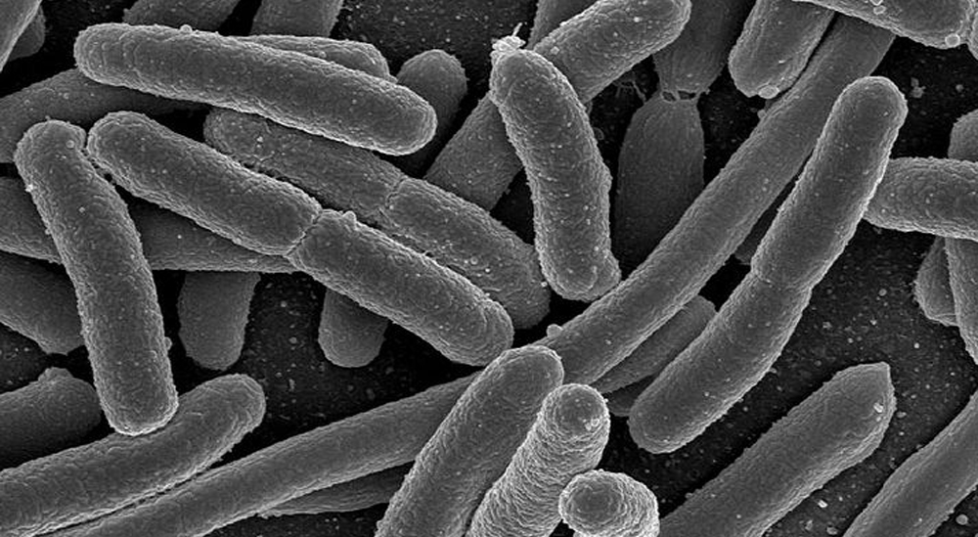
Bacteria

Slide 4
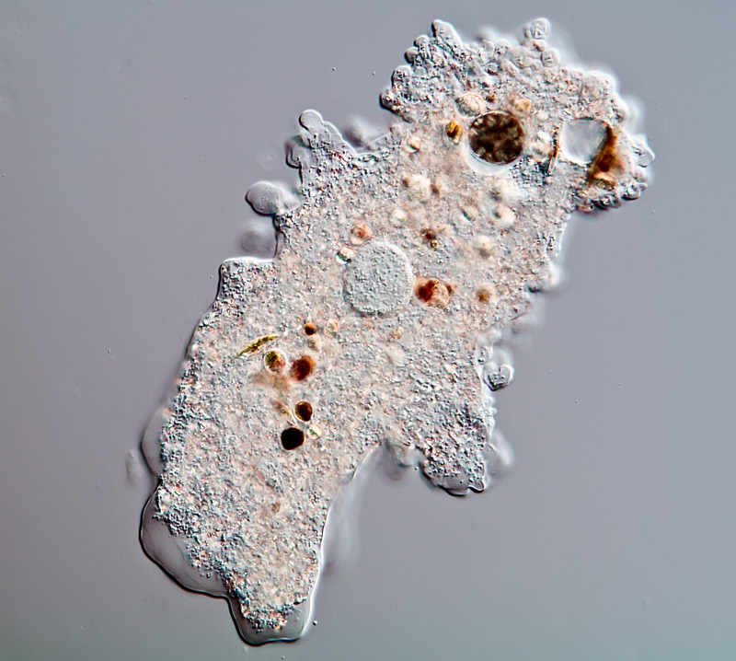
Amoeba

Slide 5
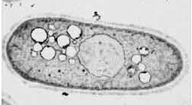
Yeast

Slide 6
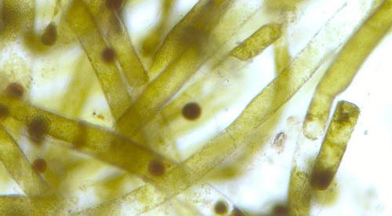
Algae

