Slide 1
Science EOG Released Form
2013

Slide 2
D – an object with more mass requires more force to start or stop it

Slide 3
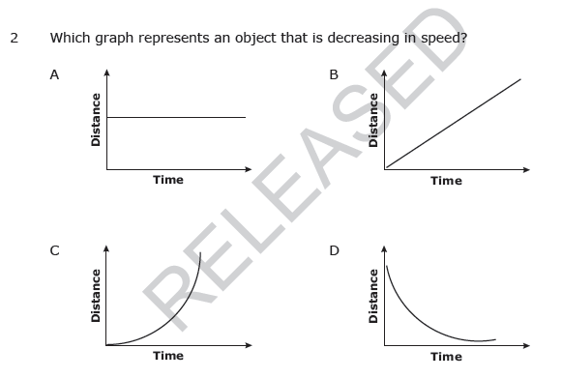
D – note that the curve of the graph stretches out toward the x-axis as it progresses. A steeper, curving slope indicates higher speeds. When the slope flattens out, the speed decreases because the distance is not increasing though time continues.

Slide 4
B – with more speed, an object will travel greater distance in the same amount of time

Slide 5
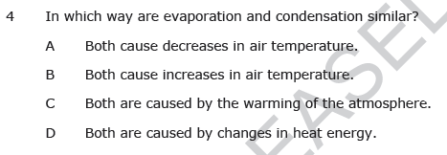
D – evaporation and condensation do not cause changes in air temperature, eliminating A & B. Condensation is caused by cooling the atmosphere. Thus, D has to be the correct answer.

Slide 6
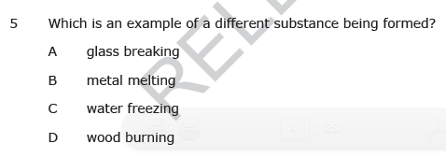
D – only wood burning is a chemical change, in which a new substance is being formed.

Slide 7
B – When air is warmed, it rises, causing cooler air to rush in and take its place, causing convection cells in the air and convection currents in water.

Slide 8
D– Conduction is when heat transfers through a conductor, or material, like metal, that allows heat to move through it easily.

Slide 9
D– Conduction is when heat transfers through a conductor, or material, like metal, that allows heat to move through it easily.

Slide 10
A – B cannot be correct because warm air rises, C is not correct because cool air doesn’t rise, D is incorrect because the cool air, under higher pressure than warm air, will move to where warm air has risen and made room for it.

Slide 11
B – low pressure systems usually bring bad weather – the teacher can model feeling “low” or gloomy to help students remember.

Slide 12
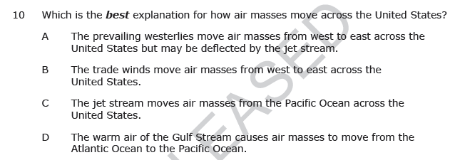
A – weather patterns in the United States move west to east. The teacher can pretend to be wind, stand in front of a map and say “We!”(west to east) to help student remember this fact.

Slide 13
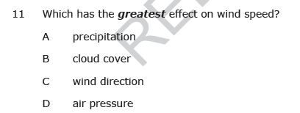
D – Help students keep in mind what happens in a convection cell. If there is high air pressure, it is going to move to where there is low pressure. Have student huddle close together to feel what molecules might “feel” like under high pressure and to remind them how badly they want to get away to an low pressure area. The greater the difference between the high and low pressure or the shorter the distance between the high and low pressure areas, the faster the wind will blow. Wind also blows faster if there's nothing in its way, so winds are usually stronger over oceans or flat ground.

Slide 14
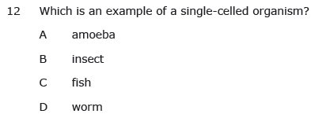
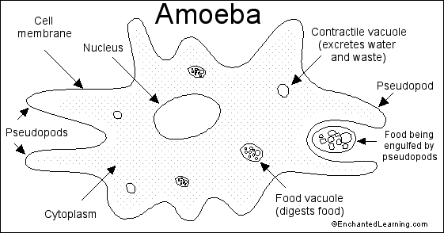
A –

Slide 15
A– Multi-cellular organisms are too big and not all of their cells have contact with the external (outside) environment. All organisms need to exchange substances with their environment - take in needed molecules and get rid of waste.

Slide 16
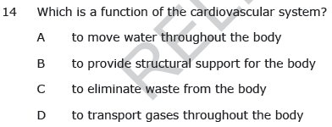
D – One job of the cardio-vascular system is to supply oxygen to all the cells in the body. Every cell in the body requires a constant supply of oxygen to stay alive. Because most of the cells are not in contact with air, the circulatory system must supply them with oxygen. When a person inhales, air enters the lungs, and oxygen is then absorbed across the membrane of the lungs into the bloodstream. This oxygen-rich blood is pumped through the heart to smaller and smaller blood vessels throughout the body. In the tiniest blood vessels, called capillaries, oxygen diffuses out of blood and into cells. At the same time, carbon dioxide produced by the cells is absorbed back into blood, which then returns to the lungs, releases carbon dioxide and picks up more oxygen. Read more: http://www.livestrong.com/article/164894-5-major-functions-of-the-cardiovascular-system/#ixzz2PtHJp42m

Slide 17
C– The nervous system is a network of cells called neurons which transmit information in the form of electrical signals. Your brain has around 100 billion neurons, and each communicates with thousands of others – as many connections as in the world's telephone system, the biggest machine on the planet. Neurons communicate with each other at special junctions where chemicals help to bridge the gap between one neuron and the next.

Slide 18
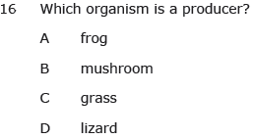
C– Producers make their own food through the process of photosynthesis. Frogs and lizards must eat food from outside sources, and mushrooms are decomposers - they break down other organisms so their bodies can become part of the soil. Grass is the only option that is a producer. Tell students – “Producers = Plants.”

Slide 19
B– Bacteria is a decomposer. As such, it breaks down dead plants and animals to enrich the soil.

Slide 20
C – With loss of habitat for woodpeckers come loss of habitat for their food supply.

Slide 21
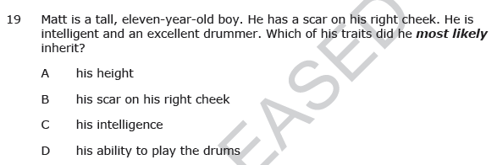
A – Height is the trait with the closest direct link to his parents’ DNA

Slide 22
B – Hair style is not inherited.

Slide 23
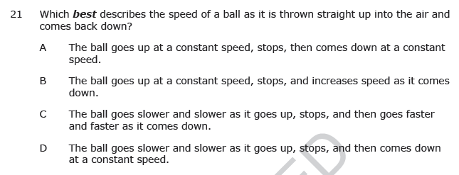
C – The force of friction and the force of gravity will slow a ball thrown straight up. As the ball falls, the force of gravity pulls on the object increasing acceleration .

Slide 24
B – When an object is moving, it would remain in motion, however outside forces act on objects, slowing them down or causing an increase in speed.

Slide 25
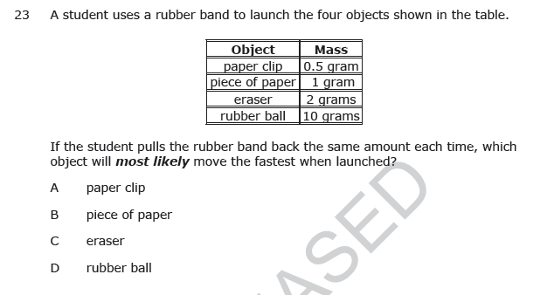
A – Because the paper clip’s mass is least, it will accelerate more with the same amount of force applied.

Slide 26
C – Evaporation is caused when water is heated and then changes state from liquid to gas.

Slide 27
D – Because this solution is a mixture, and because the mass of the salt and the mass of water stay the same, even after the salt is dissolved, the mass of the two combined would be equal to the sum of the parts in the solution.

Slide 28
D – Because this solution is a mixture, and because the mass of the salt and the mass of water stay the same, even after the salt is dissolved, the mass of the two combined would be equal to the sum of the parts in the solution.

Slide 29
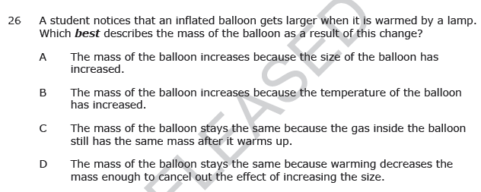
C – When the air inside the balloon heats, it’s molecules spread apart. The same amount of air/molecules are inside the balloon, so the mass of the air is the same.

Slide 30
D – Radiation occurs when heat is transferred through space. The heat from the fire moves through space to reach the people sitting nearby.

Slide 31
A – In a convection cell or current – warm water or air rises and cool water or air sinks, so the water around Bill’s feet would be cooler than the water near the surface.

Slide 32
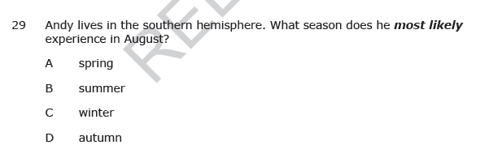
C – It is winter in the southern hemisphere in August because the southern hemisphere’s seasons are exactly opposite of those in the northern hemisphere.

Slide 33
C – High pressure systems typically bring fair weather. Tell the student that when someone is “riding high,” they are feeling good to help them remember.

Slide 34
A – The jet stream, a global air current, acts sort of a wall between polar air masses and warmer air masses to the south of it. The latitude of the jet stream helps to determine how far south polar air will reach.

Slide 35
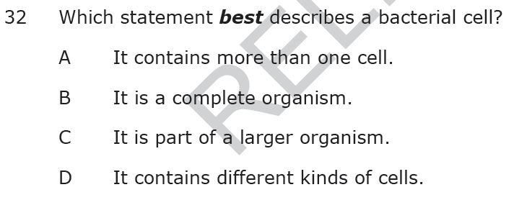
B – Bacteria are single-cell organisms.

Slide 36
C – All organisms need to get rid of waste products, whether they are single celled or multicellular.

Slide 37
A – The skeletal system protects major organs – the skull protects the brain and the rib cage protects other major organs.

Slide 38
A – The skeletal system protects major organs – the skull protects the brain and the rib cage protects other major organs.

Slide 39
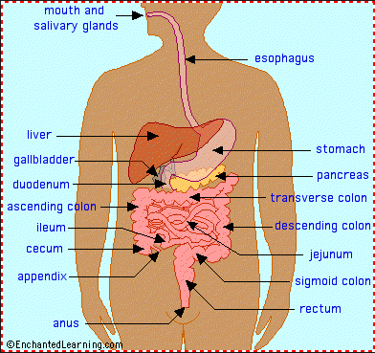
D –

Slide 40
A – Since eagles eat snakes, the snake population will grow if there were less eagle around.

Slide 41
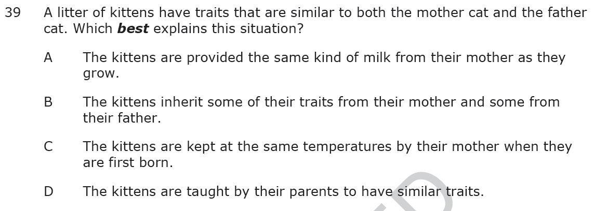
B – Traits are inherited and they come from both parents.

Slide 42
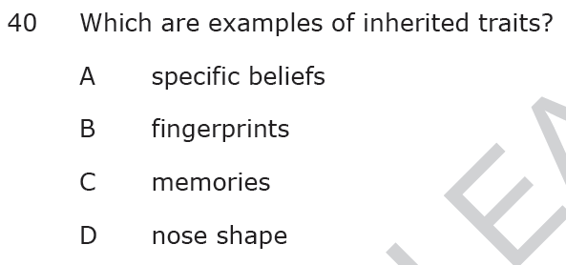
D – Beliefs and memories are developed through life experiences. Fingerprints are unique to each individual, so the answer has to be nose-shape.

Slide 43
C – The force of gravity pulls objects to earth.

Slide 44
B – The friction of the air around the wagon and from the wheels rubbing on the ground as they roll are mainly responsible for stopping the wagon.

Slide 45
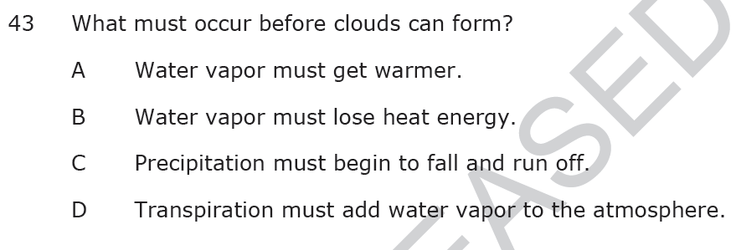
B – Don’t let your students be tricked! Condensation, cool, cloud is the same. Losing heat energy is the same as “cooling down.”

Slide 46
D – Transpiration is when plants lose water from their leaves. The only other plant process in this line-up is “A”- photosynthesis, but that’s the process by which plants make their food.

Slide 47
B – Water in the environment “disappears” as it turns into water vapor during the process of evaporation.

Slide 48
D – When matter heats, it expands, so the tracks would lengthen slightly, but the mass of the object remains the same after the interaction (heating).

Slide 49
C – When a front moves in, whether cold or warm, we can expect precipitation. When a cold front moves in, severe storms occur, and the precipitation does not last long. When a warm front moves in, extended periods of rain weather follow.

Slide 50
D – El Nino warms ocean temperatures, causing extreme severe weather.

Slide 51
D – When the jet stream, which acts as a barrier holding polar air masses north of it, moves below North Carolina, then polar air reaches us, and we have cold weather.

Slide 52
C – Unicellular organisms are single-celled (indicated by the prefix “uni-” meaning “one” – “uno”for Spanish-speakers). Multicellular organisms have many cells (indicated by the prefix “multi-” meaning “many.”)

Slide 53
B – The digestive system processes food into energy we can use.

Slide 54
D – A mushroom is a decomposer because it breaks down dead plants and animals.

Slide 55
C – Humans have overtaken the habitat sea turtles need to breed, or make new life.

Slide 56
B – If predators don’t have the prey they need to survive, their populations will decline.

Slide 57
B – Lizard and hawk populations will decrease if they don’t have a food supply big enough to keep them alive.

Slide 58
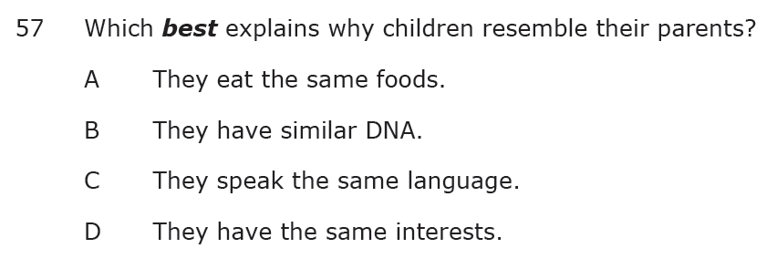
B – DNA is the genetic code that tells who a person will be. Inherited traits, such as hair color, nose shape, and eye color all come from a parent’s DNA.

Slide 59
A – Offspring (children) have many of the same characteristics as their parents because they inherit those characteristics through shared DNA.

Slide 60
C – Children, whether human or non-human, learn to eat the foods presented to them, often based on what is available in the environment in which they live.

Slide 61
A – Musical ability can be learned, personality is developed through experience, and language is learned. The shape of earlobes is an inherited characteristic.

