Slide 1
EQ: How does the circulatory system function within the body?

Slide 2
Review
Turn and Talk:
What parts compose the circulatory system?

Slide 3
Parts of the Circulatory System
Heart
Blood
Blood Vessels
Arteries (take blood AWAY from the heart)
Veins (bring blood back to the heart)
Capillaries

Slide 4
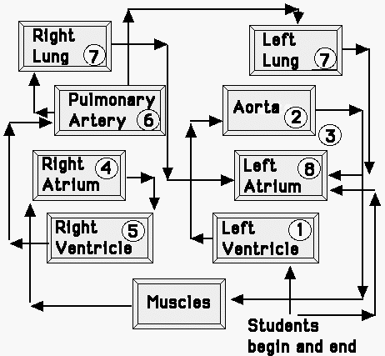
Circulatory System Relay
Notes:
Show students the relay course and review the circulatory system pathway. Explain that they will be going out on the basketball court to walk the circulatory system pathway. Go over the course and how they will walk. Students will be walking through in table teams. Explain to students that the red balloons will represent oxygenated blood cells. Meanwhile, the blue balloons will represent carbon dioxide loaded blood cells that have given away their oxygen and are now carrying away the cells' waste.

Slide 5
Let’s go!
Things to remember:
What is our purpose outside?
Stay focused on your purpose!

Slide 6
EQA:
How does the circulatory system function within the body?

