Slide 1
Day 7
Which body parts compose the circulatory system?

Slide 3
The Heart
The heart is the main organ in the circulatory system. Blood vessels and blood also make up this system.

Slide 4
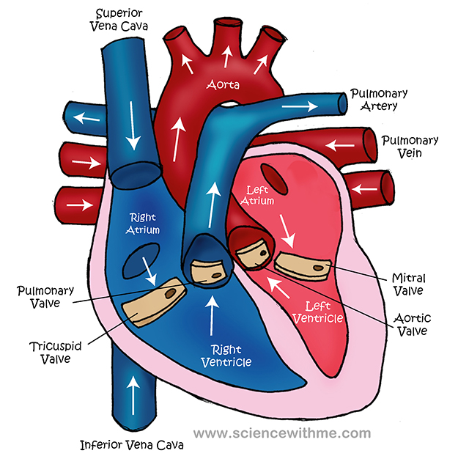
The Heart

Slide 5
The Heart
Click here for an online model of the heart.
http://www.smm.org/studio3d/julie/hearthome.htm

Slide 6
Notes
Also called the “cardiovascular system”
(cardio → heart)
Vessels = tubes that carry blood
1. Arteries – vessels that move blood away from the heart
2. Veins – vessels that carry blood back to the heart
3. Capillaries – “back roads” to every cell

Slide 7
Reading
Purpose for Reading:
Quote facts from the text and organize them by meaning.
Important | Interesting

Slide 8
Reading
Your Cardiovascular System
Important | Interesting

Slide 9
Quick Write
In a paragraph, answer the EQ.
Remember to include correct capital letters and punctuation; as well as correct spelling.

