Slide 1
EQ: What purpose does the muscular system serve in the body?

Slide 2
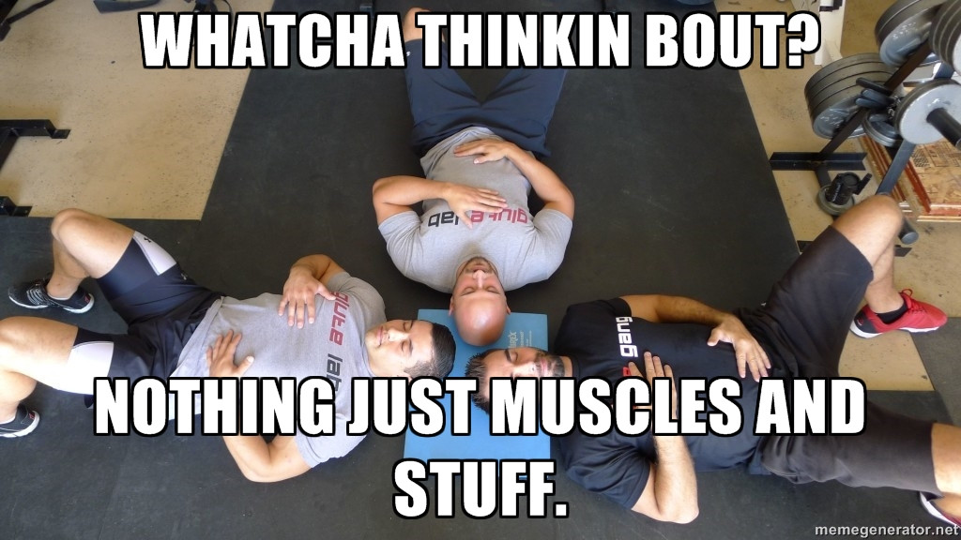

Slide 3
Brainstorm
At your table, brainstorm a list of all the things our muscles enable us to do.
1 minute!
Notes:
Give students one minute to brainstorm ideas. Circulate and guide students toward ideas they may not have considered, like pump blood through our body, digest our food, breathe, chew our food, shiver, etc.

Slide 4
Share
What do our muscles enable us to do?
Notes:
List all ideas on the board and guide students to think of ideas that they may not have considered, if they are not thinking very deeply! (pump blood through our body, digest our food, breathe, etc.)

Slide 5
I like to move it, move it
Looking at our list, what do all of these things have in common?
MOVEMENT!
Notes:
The muscular system is responsible for all of the movement in the body.

Slide 6
You’re not the boss of me!
Voluntary muscle – muscle that responds when thinking about movement
Involuntary muscle – muscle that does not respond to thinking about movement
Notes:
Quickly explain the difference between voluntary and involuntary muscle. We will go into further depth, so for now, a short explanation is enough. Record next to the list of movements students listed either an “I” or a “V” for involuntary or voluntary.

Slide 7
Investigate
Turn to page A22 in your Science textbook.
We will investigate how muscles cause movement.
Materials needed: measuring tape, journal, pencil
Notes:
Read through the Activity Purpose and Procedure together. This is good practice for reading directions for meaning.

Slide 8
Scientists Record Observations
Record your observation about the movement in your right arm.
Record the comparison between your bicep and your tricep. Which muscle controls the bending movement and how do you know? Which muscle controls the straightening movement and how do you know?
Record measurements:
Right arm straight ____
Right arm bent ____
Left arm straight ____
Left arm bent ____
Notes:
Have students record after each step. As they finish, they answer questions one and two under “Draw Conclusions” in their journal.

Slide 9
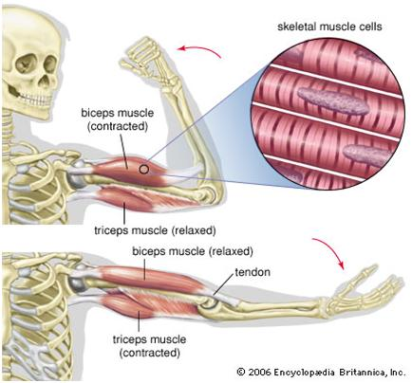
Notes:
Skeletal muscles that are attached at joints usually work in pairs. Why?

Slide 10
Explain
Reading:
“Muscles, Muscles Everywhere”
with directed notes

Slide 11
Vocabulary Cards
Muscles
Tendons
Muscular system

Slide 12
EQA:
What purpose does the muscular system serve in the body?

