Slide 1
Day 3
What composes the skeletal system?

Slide 2
Quick Review:
What are the main functions of the skeletal system?
Refer to notes from yesterday.

Slide 4
Read to answer the question
Ligaments and Cartilage
Blendspace: Skeletal
What are bones and what do they do?

Slide 5
What is the skeleton composed of?
Bones
Joints
Ligaments
Cartilage
Vocabulary Cards for Each

Slide 6
Immobilized Joints
Activity
Materials:
Tape
Popsicle Sticks

Slide 7
Immobilized Joints
How did it feel to have your joints immobilized?
What tasks were the hardest to do?
Were there any you couldn't do?
What did you do to compensate for problems you had?

Slide 8
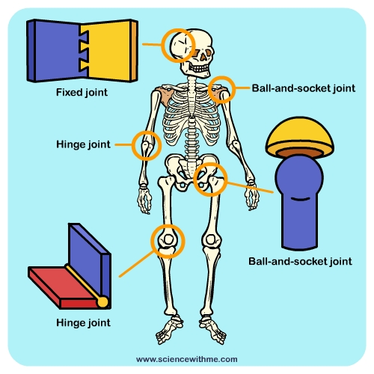
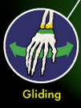
Types
of
Joints
Add Gliding
Record examples in notebook.

