Slide 1
Day 2
What is the function of each body system?

Slide 2
Quick Review:
What is a function?
Refer to vocabulary card from yesterday.

Slide 3
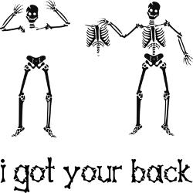

Slide 4
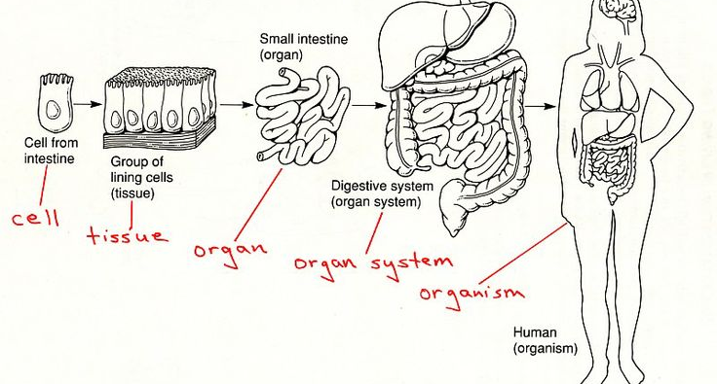
Your body is organized into systems. Today, we will determine the function of each system.

Slide 5
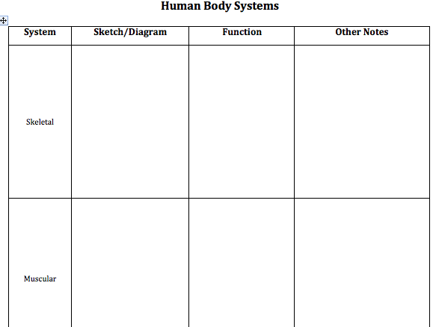
Read to complete guided notes
Prezi
Quizlet

Slide 6
Vocabulary Cards
List the main function of these systems on new vocabulary cards.
Skeletal
Muscular
Respiratory
Circulatory
Nervous
Digestive

