Slide 1
Day 1
How is your body organized?

Slide 2
Quick Review:
What are cells?
All living things are made up of a cell or cells. This includes our bodies.

Slide 3
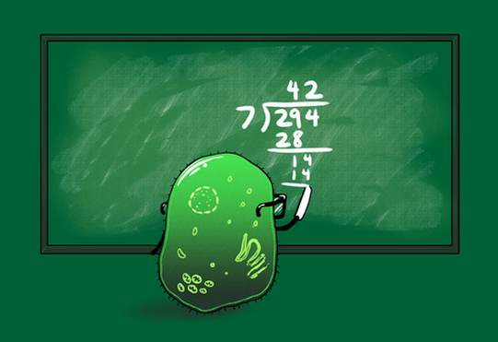
Cell Division

Slide 4
What’s inside of you?
On your corner of your team’s placemat, write a paragraph to answer the question using what you already know.
Be sure to use capital letters and punctuation where you are supposed to; along with correct spelling.

Slide 5
What’s inside of you?
Share paragraphs at your table. Discuss what you included in your paragraphs, and work together to write a team paragraph that includes everyone’s ideas.
Be sure to use capital letters and punctuation where you are supposed to; along with correct spelling.

Slide 6
Watch the video…
While watching, please listen for the answer to this question:
How are our bodies built from cells?

Slide 7
Science in Elementary: What’s Inside Your Body? Systems
Discovery Education

Slide 8
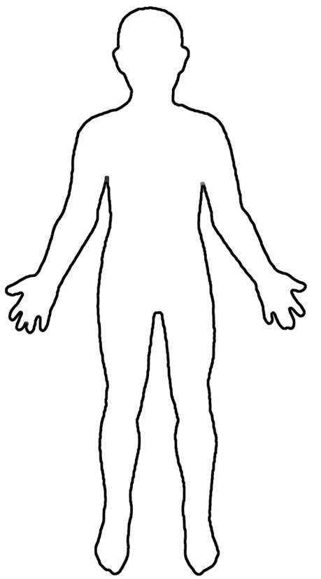
How do you build a body from cells?
Cell
Organ
Tissue
Organ System
Body

Slide 9
Glue this into your science notebook.

Slide 10
Vocabulary Cards
Function: The job or purpose of a cell, organ, system, or organism.
Tissue: A group of cells that work together to perform a specific function.
Organ: A collection of tissues that carry out a specialized function of the body.
(A part of the body that has a specific job, like the brain, heart or lungs.)
Body System: A group of organs that work together to perform a specific function.
Examples are the skeletal system, muscular system, respiratory system, circulatory system and digestive system.

