Slide 1
EQ: How does the respiratory system function within the body?

Slide 2
Breathing is essential for life.
Why do we need to breathe?
What is it in the air that is so important to us?
Notes:
Breathing is essential for life. We breathe in oxygen from the air. All parts of our body need oxygen to survive and function because oxygen is used to make energy.

Slide 3
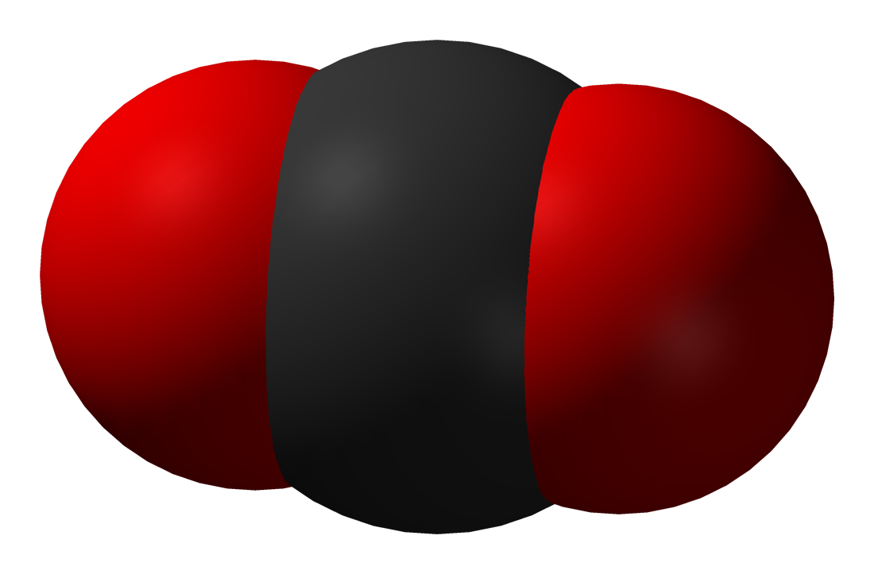
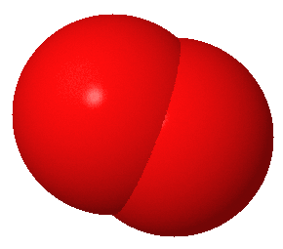
It is the oxygen from the air that we need!
+
+
Energy!
Oxygen
Food
(Glucose)
Waste
(Carbon Dioxide)
Notes:
It is the oxygen from the air that we need! All cells in our body need energy to survive and function. They make energy using the oxygen that we breathe in and the foods that we eat.

Slide 4
Straw Investigation
What happens when someone gets less air than what they need?
Remember that oxygen works together with food to produce energy.
With less oxygen, the cells make less energy to carry out the body’s functions.

Slide 5
Straw Investigation
What kinds of things would prevent us from getting the normal amount of air when we breathe?
Does anyone have or know someone who has asthma?
Notes:
Asthma is a lung disease involving repeated breathing problems. The lungs in people with asthma are supersensitive to triggers they encounter in the environment, often including cat dander, dust mites, mold, pollen, smoke, pollution, cold air, and exercise. These triggers can cause asthma attacks, which include wheezing, coughing, and difficulty breathing.

Slide 6
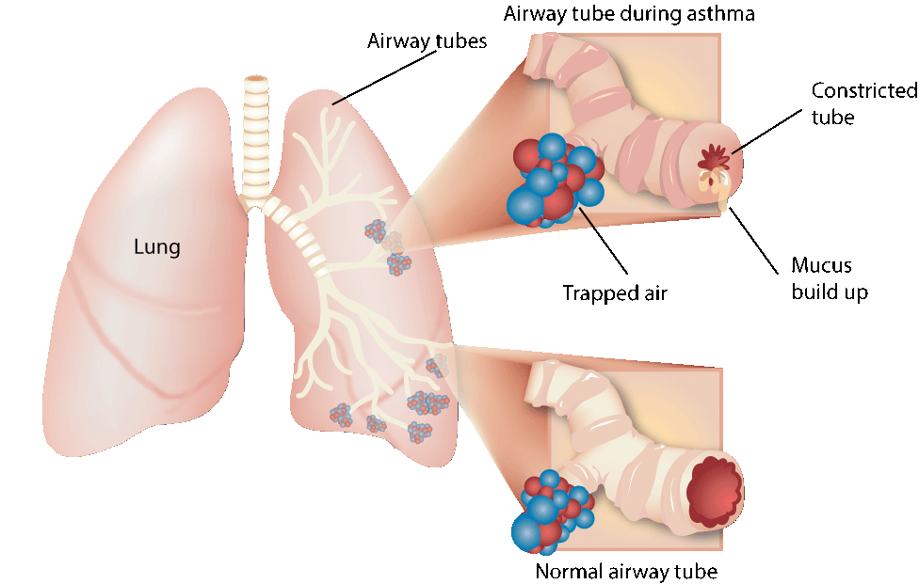
Notes:
During an asthma attack, the airways in the lung narrow. In response to an environmental trigger, airways become inflamed or swollen and begin to produce mucus. The muscles around airways contract, further narrowing the openings and making it difficult to breathe. This narrowing may reverse naturally with time, or with treatment and medication.

Slide 7
Straw Investigation
Take 5 deep, normal breaths.
Now, take 5 deep, normal breaths out of the straw.
Each table will get a piece of paper to crumble up.
Try to blow the paper across the table with your straw.
Now, try with your normal breath.
Quick Write: Was using the straw to breathe and blow easier or more difficult? Why?

Slide 8
Straw Investigation
When you breathe through the straw, this is similar to breathing through smaller airways (like in asthma) but also like having less lung space (like in smoking).
The less amount of oxygen in the body, the less oxygen to the muscles.
Would it be harder to run around and play if you could only breathe through a straw?

Slide 9
EQA:
How does the respiratory system function within the body?

